Slide 1
How to get a library eBook on your iPad
Step-by-Step Guide
Prepared by the Computer Lab
Montgomery County-Norristown Public Library
October 2014

Slide 2
This presentation assumes that you have registered your iPad and created an account on iTunes. You need this in order to download the OverDrive app for managing your library eBooks. You will also need a valid email address that will be needed to sign up for an OverDrive account. This presentation uses an iPad2, but these steps can be used on any iPad device.

Slide 3
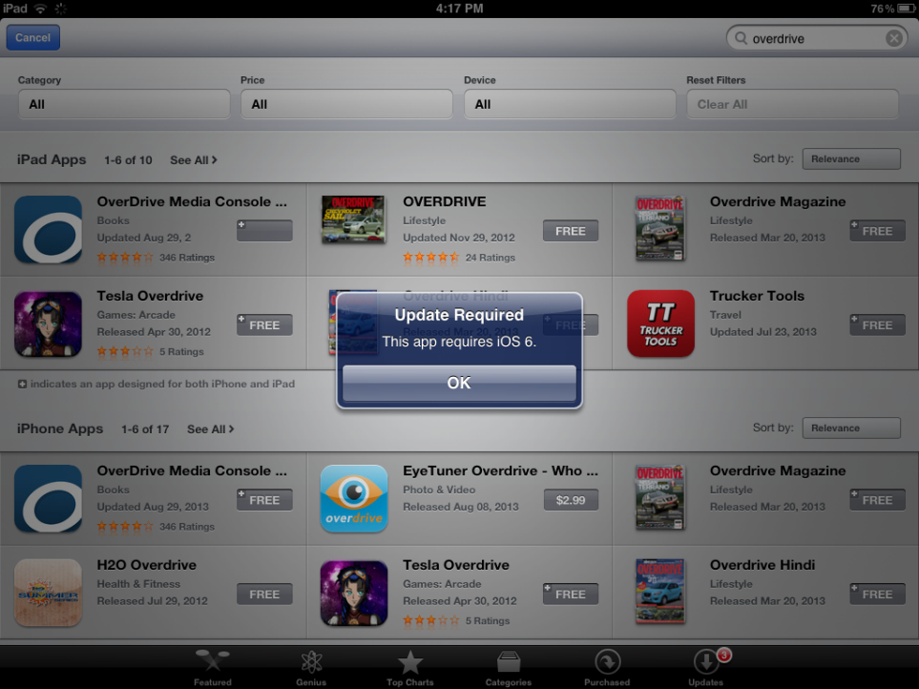
OverDrive 3.2 requires iOS 6.0 or higher. Make sure your Apple device has the latest system updates or you will be unable to download the OverDrive app. To ensure you have the latest system updates, please refer to the Apple support webpage.

Slide 4
Overview of Basic Steps
Download the OverDrive App
Sign up for an OverDrive account
Use OverDrive to search the library digital collection and check out a book
Use OverDrive to read and manage your ePub books

Slide 5
What do I need to get started?
A Library Card based on a residency in Montgomery County
Wireless access to the internet
Your Apple ID password
A valid email address
Your iPad

Slide 6
Policies and tips to bear in mind when borrowing eBooks…
Valid Montgomery County library card
Borrowing period- 7, 14 or 21 days
Borrowing limits-10 items at one time (audio and eBooks combined)
Renewable –There is a renew feature which allows you to place advance holds on titles that you currently have checked out. This feature is available three days prior to expiration of your title. You need to do this proactively. You will not be prompted. Reserving – limited to 10 items at one time (audio and eBooks combined)
Pick up a reserve book within 72 hours of email notification
Late Fees – None!
“Shopping” cart – lasts only 30 minutes!

Slide 7
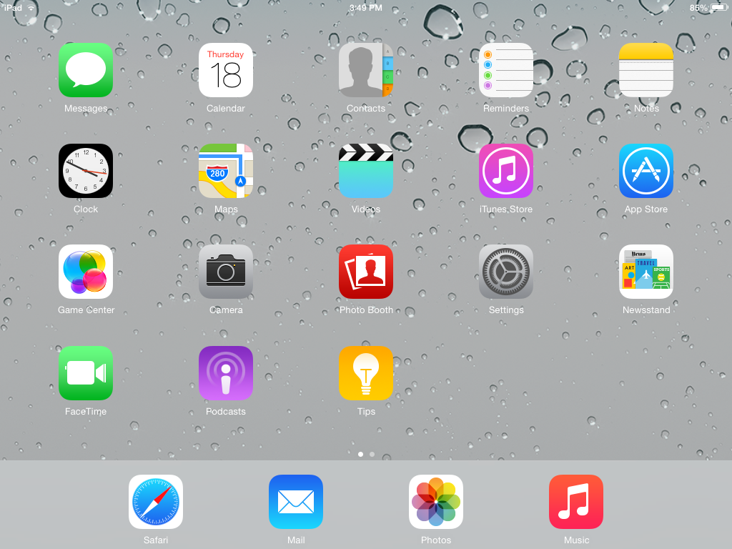
Tap on the App Store icon

Slide 8
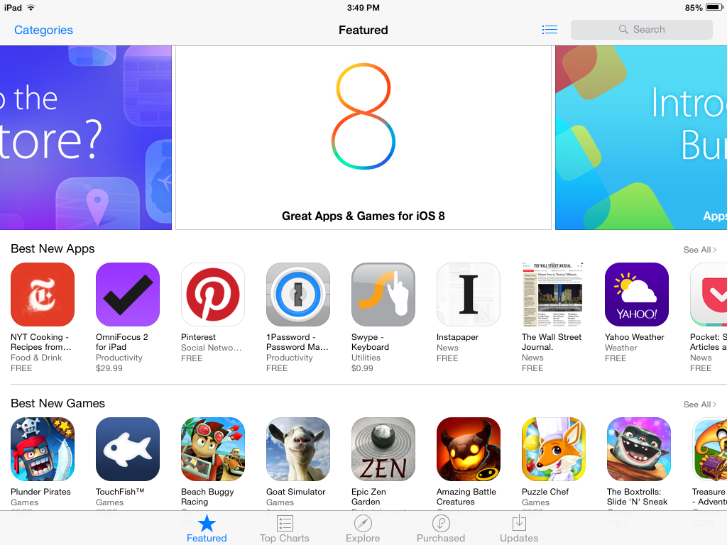
App Store is open – TAP in the Search box

Slide 9
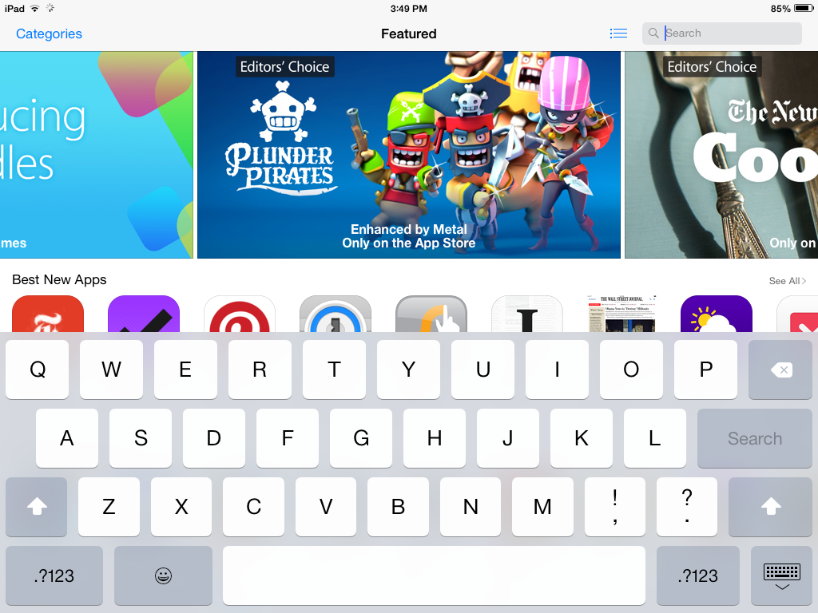
Keyboard opens

Slide 10
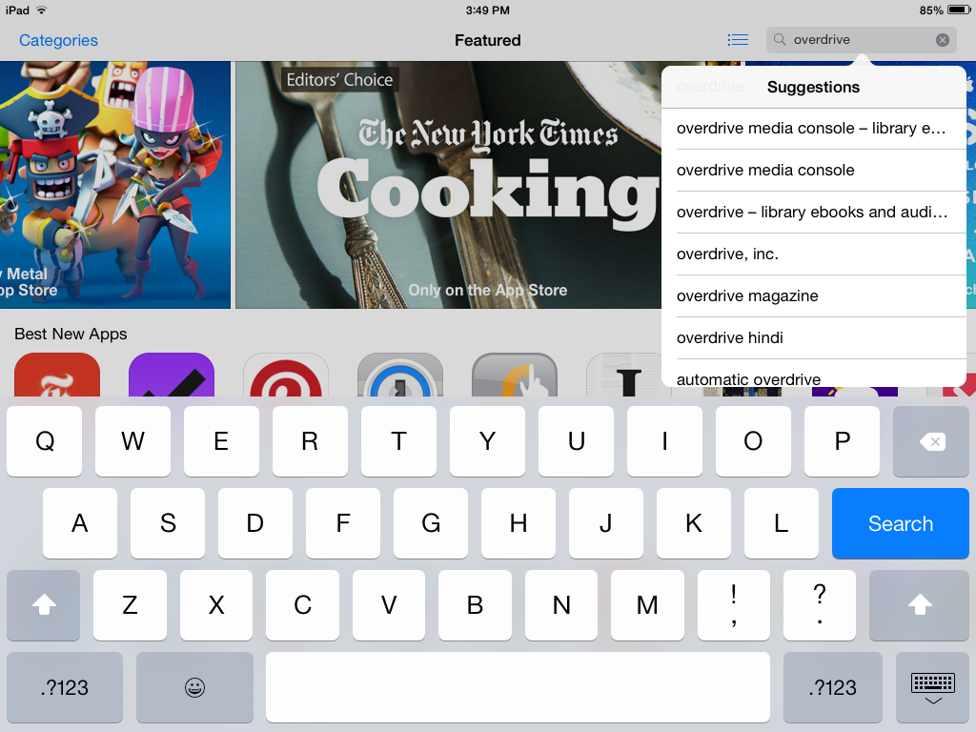
Start typing overdrive, TAP “overdrive, inc.” in suggestions list

Slide 11
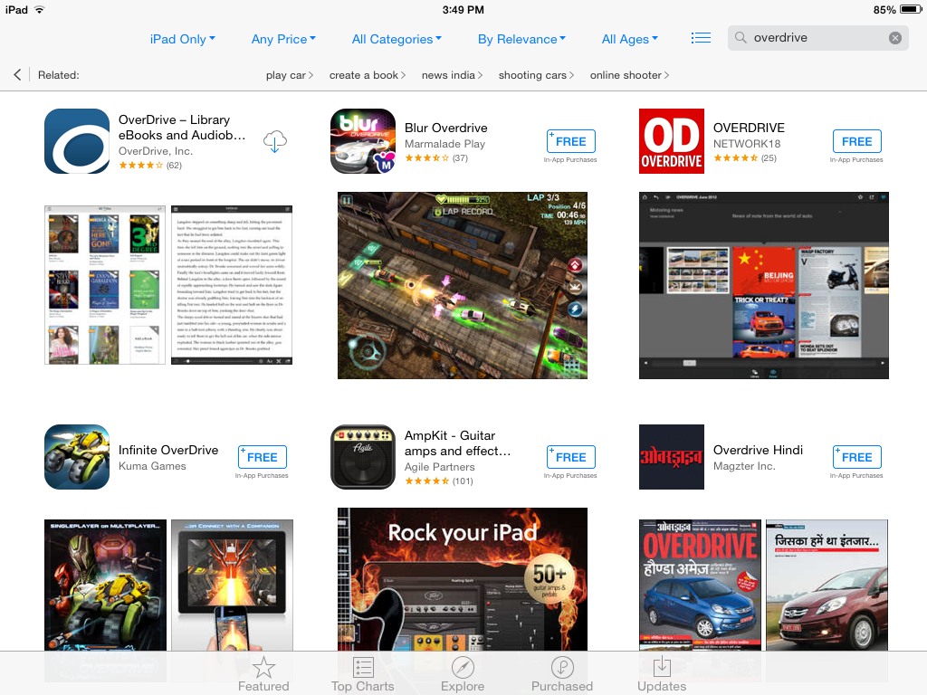
TAP anywhere in the white block surrounding the OverDrive app

Slide 12
Tap the FREE button.

Slide 13
The button will then turn green and say INSTALL. Tap it again.

Slide 14
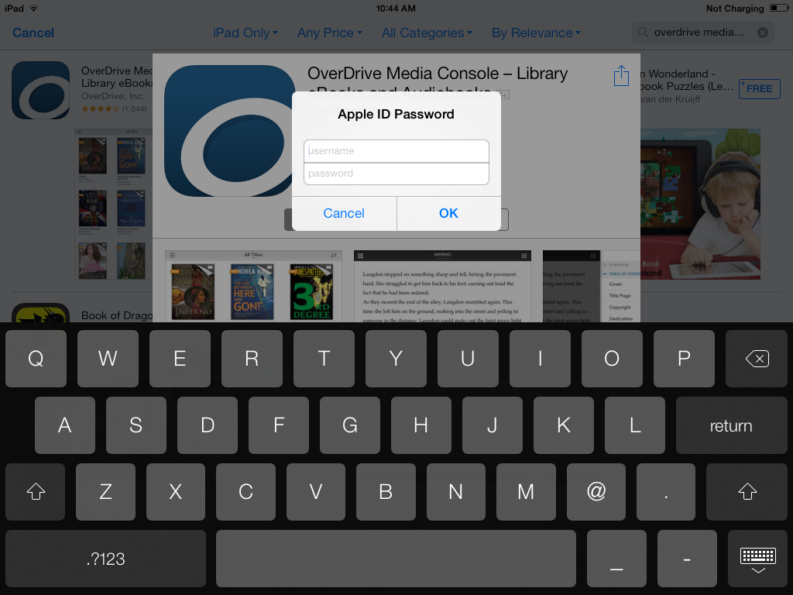
Enter your Apple ID password to confirm the download. OverDrive is a FREE app and you will not be charged to download it.

Slide 15
You will then see a circular button appear. As the app is downloaded, a bold blue line will encircle the button, which indicates the progress of the download. You can continue to wait here for the download to complete, or you can push the home button on your iPad

Slide 16
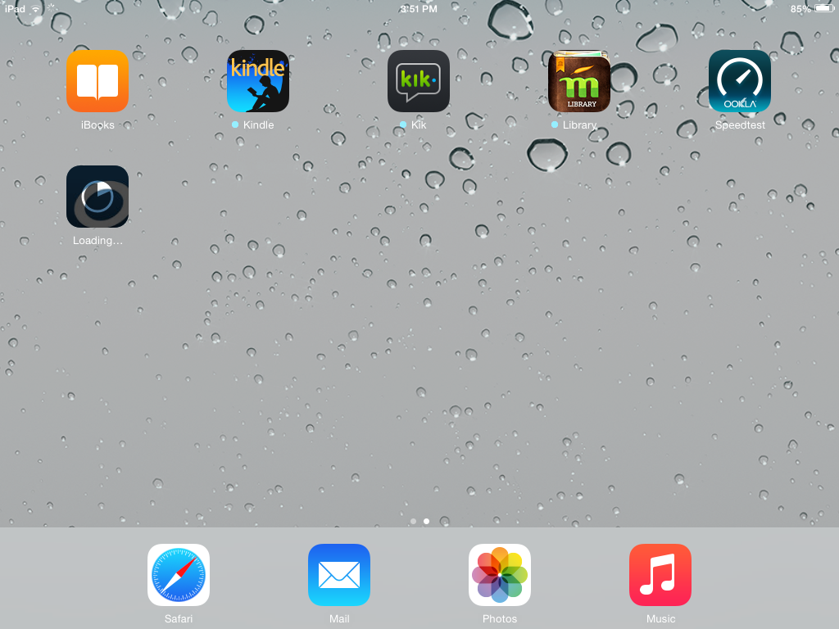
From your home screen, you can also see an icon of the app being downloaded. A status shows how much percentage the app is finished downloading.

Slide 17
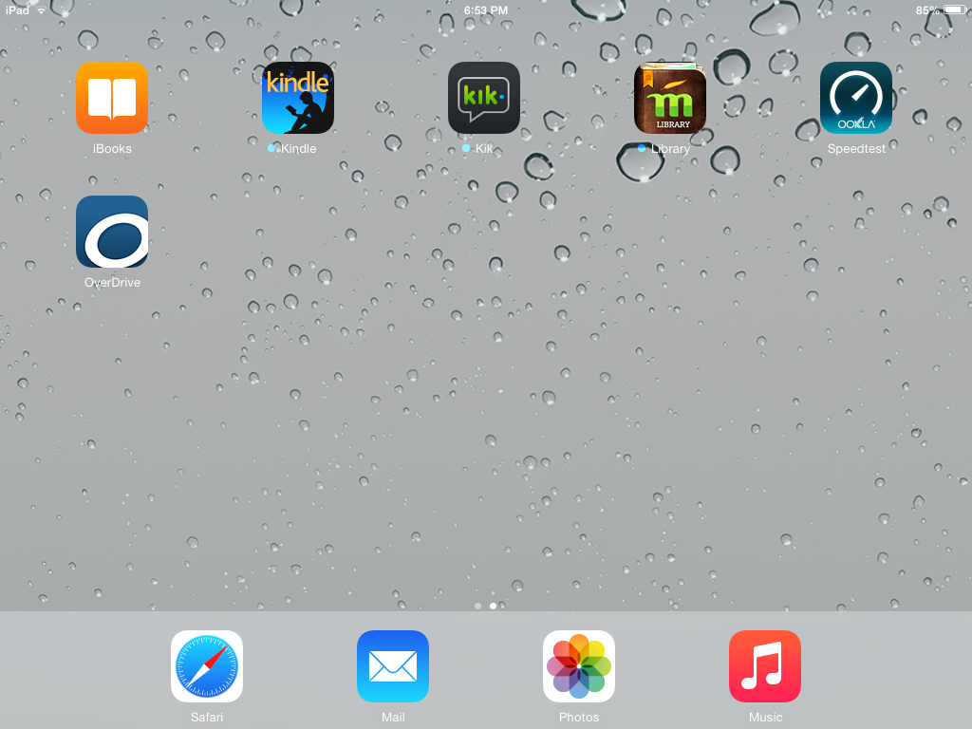
Once the app is fully downloaded and installed, the icon will look like this. Tap on it to open the app.

Slide 18
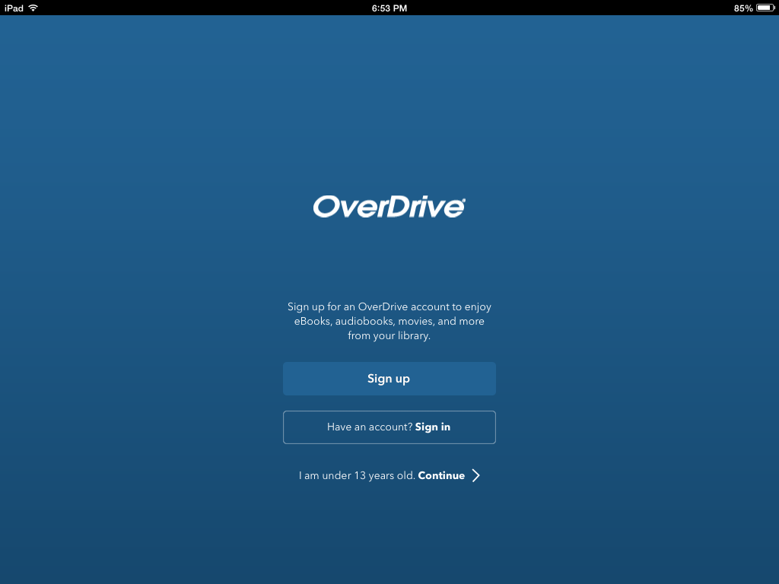
The app will open with a screen that asks you to create an OverDrive account or sign in with an existing one. If this is your first time using the app, tap on the “Sign up” button

Slide 19
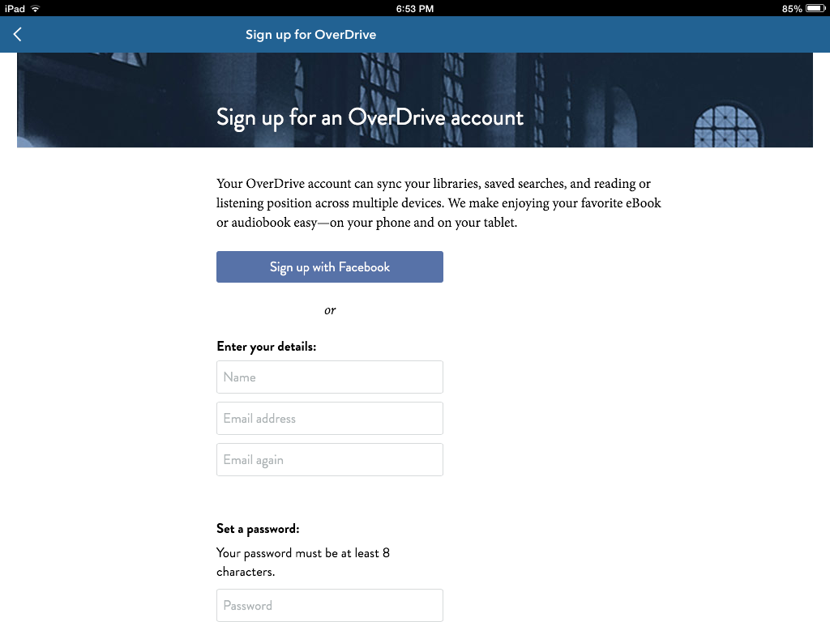
If you have a Facebook account, you can link it to OverDrive by tapping on the “Sign up with Facebook” button. This will allow you to use the same username and password you use for Facebook so you won’t have to create a new one. Otherwise, just fill out the information to manually create an OverDrive account

Slide 20
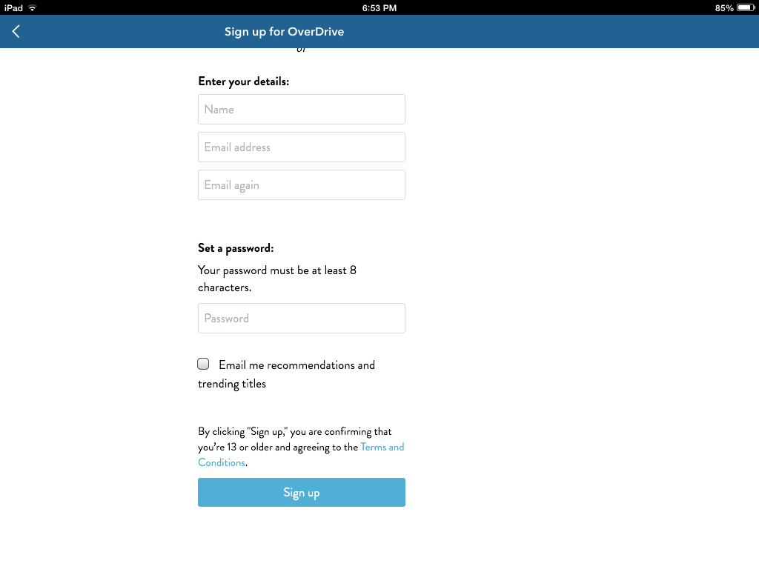
As of this writing, there is only one password field, so make sure you take your time and enter your password correctly, otherwise you may have to reset it later.
Tap on the “Sign up” button when you are finished. After this, you will be automatically signed into the OverDrive app, and you will not be required to sign in again.

Slide 21
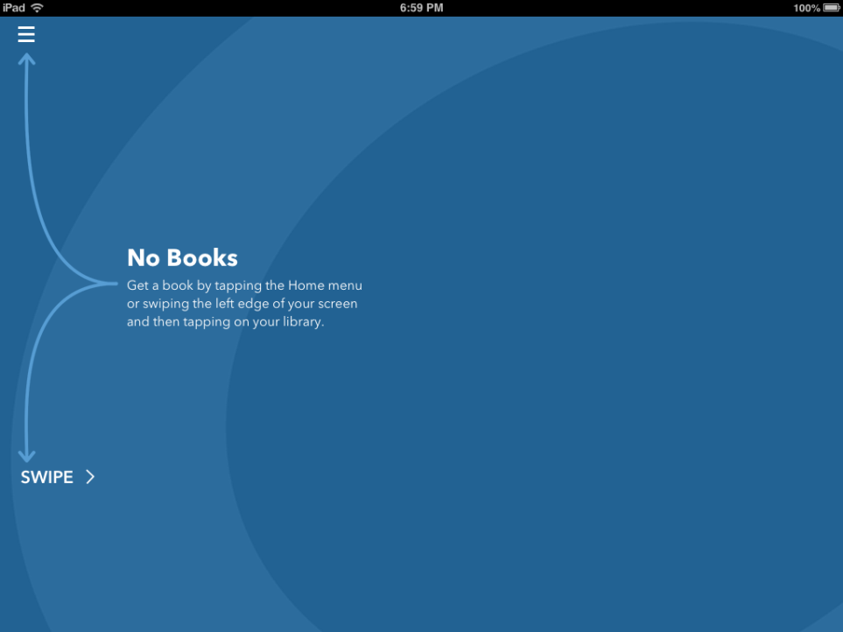
This is the homescreen of the app. After you start borrowing books, you will notice your last read book displayed here. Tap the menu button or swipe as instructed.

Slide 22
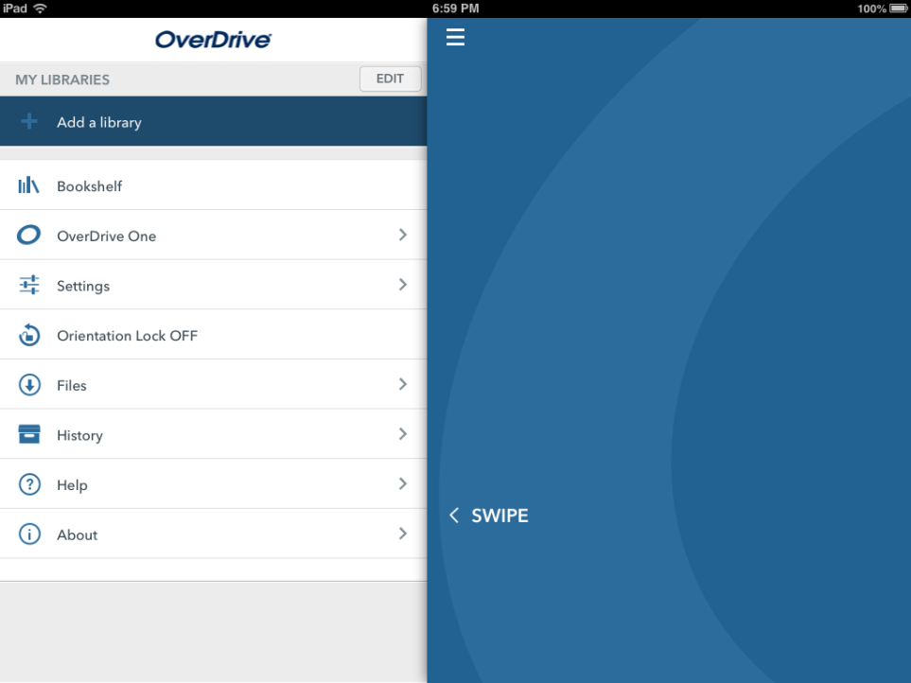
Before we can begin searching for books, we must first add our Library so OverDrive knows which website to open. Tap the “Add a library” button

Slide 23
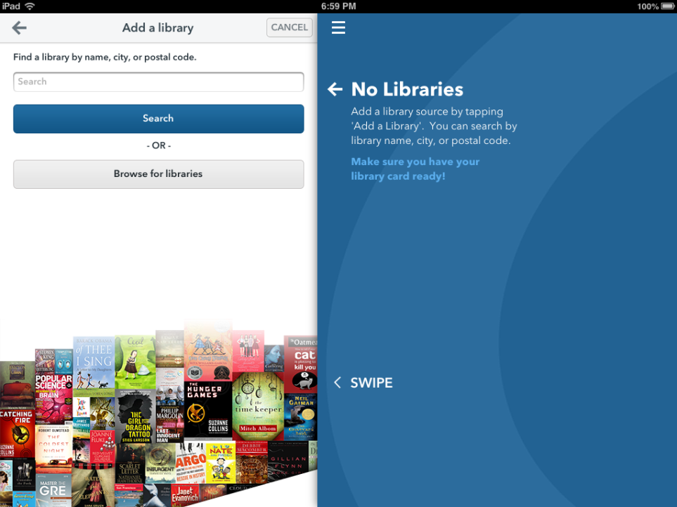
TAP in the search field

Slide 24
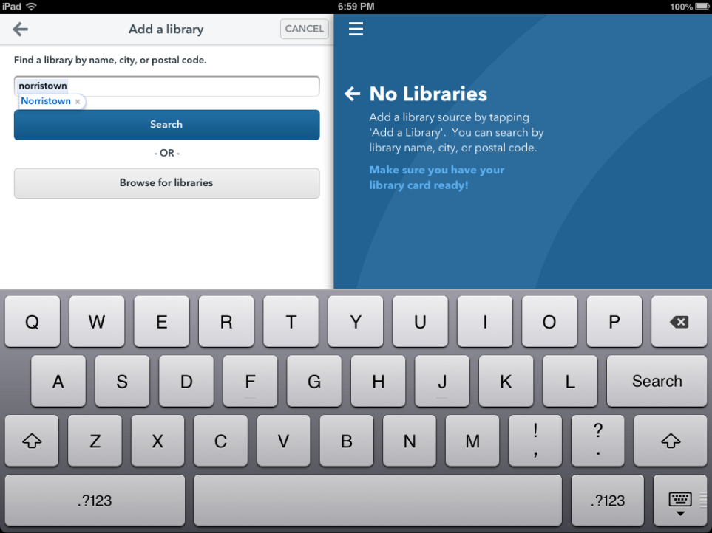
Type Norristown (or your city) and TAP search

Slide 25
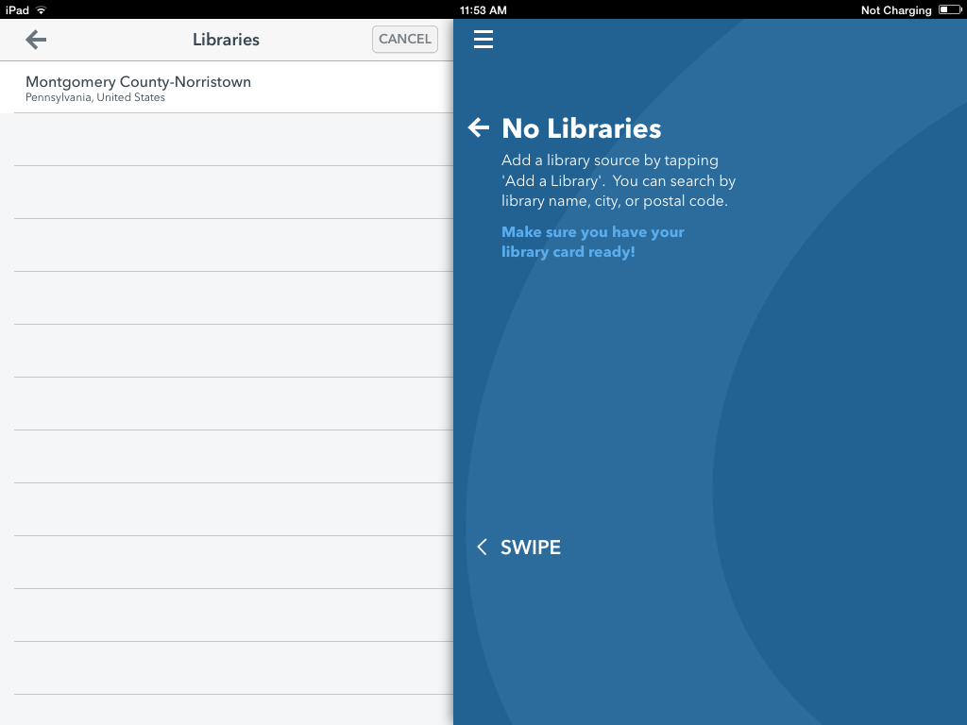
The search results will then be displayed. Tap on the library you want to access.

Slide 26
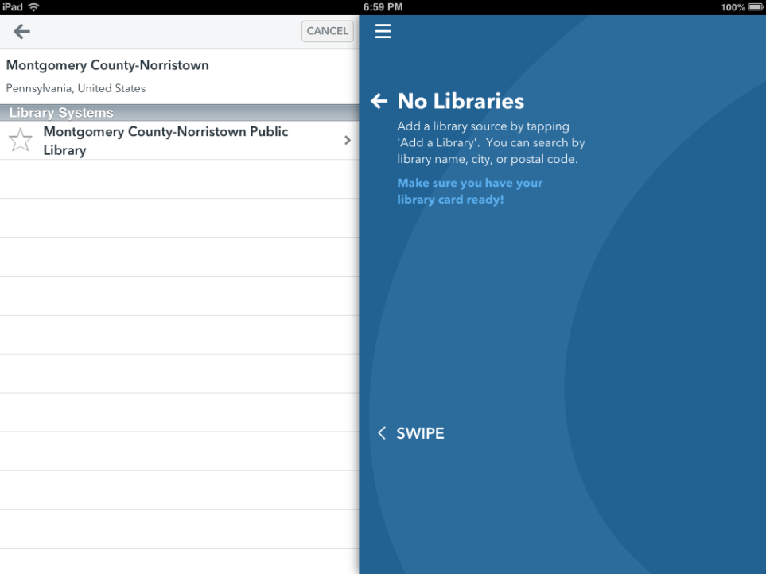
Tap the white star to add it to your libraries list

Slide 27
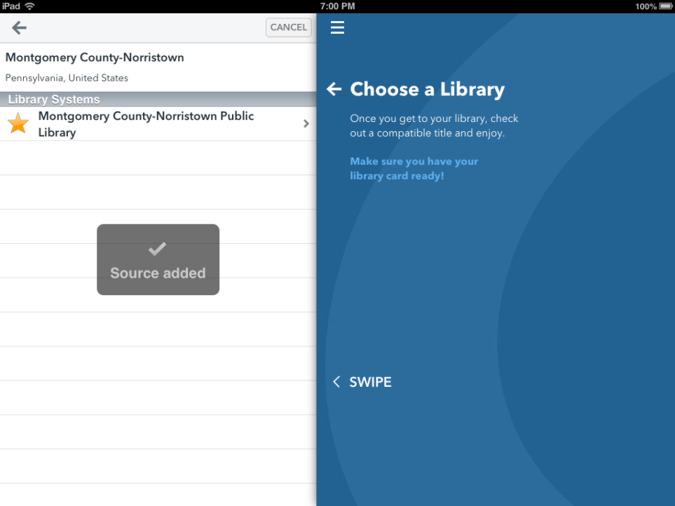
The white star turns yellow and you get the Source added feedback
TAP the library name to proceed

Slide 28
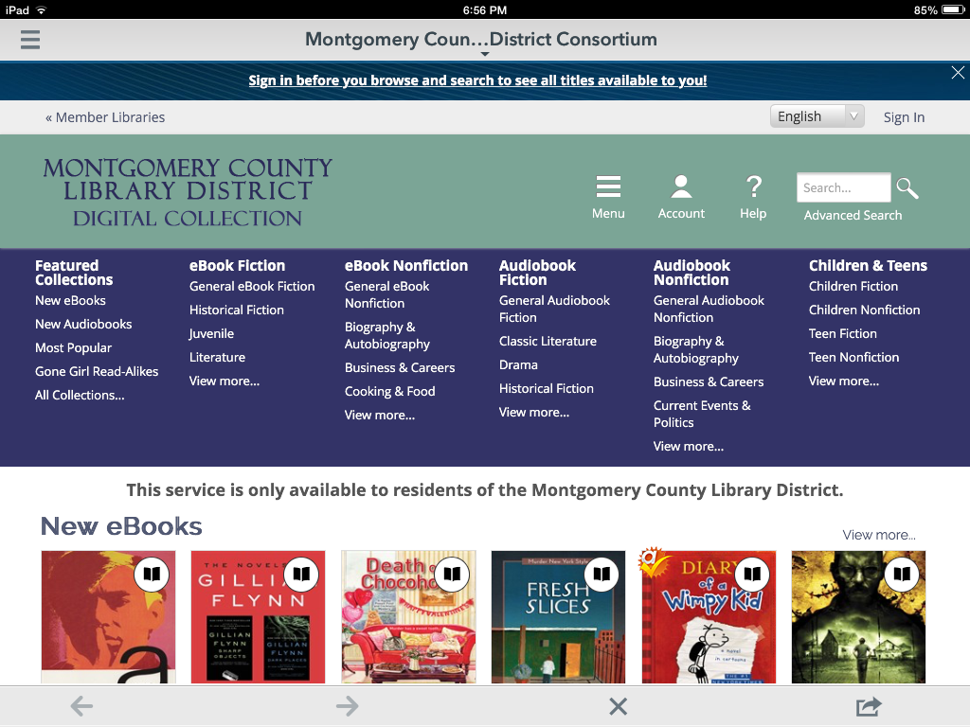
Once we tap our library name the OverDrive app takes us to the Home page of the OverDrive website which is displaying the Digital Collection for the Montgomery County Library District

Slide 29
Before you begin any Browsing or Searching of the OverDrive website, we recommend that you Sign in first
TAP Sign In

Slide 30
TAP the select library button

Slide 31
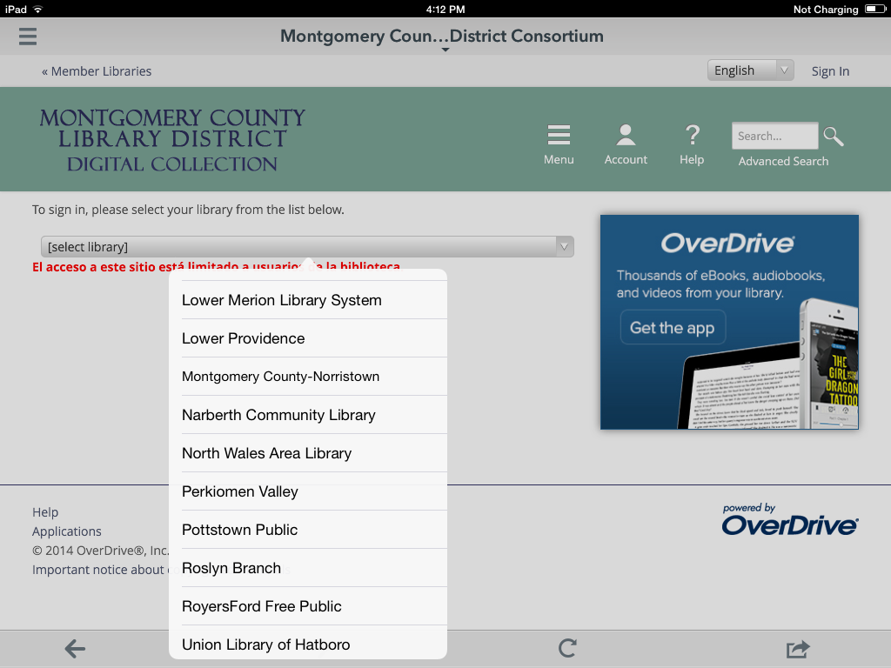
You may need to scroll to find the name of the library that serves the area where you live. When you see the name, TAP on it.

Slide 32
TAP in the Library card number field and enter your number and then TAP the Sign In button

Slide 33
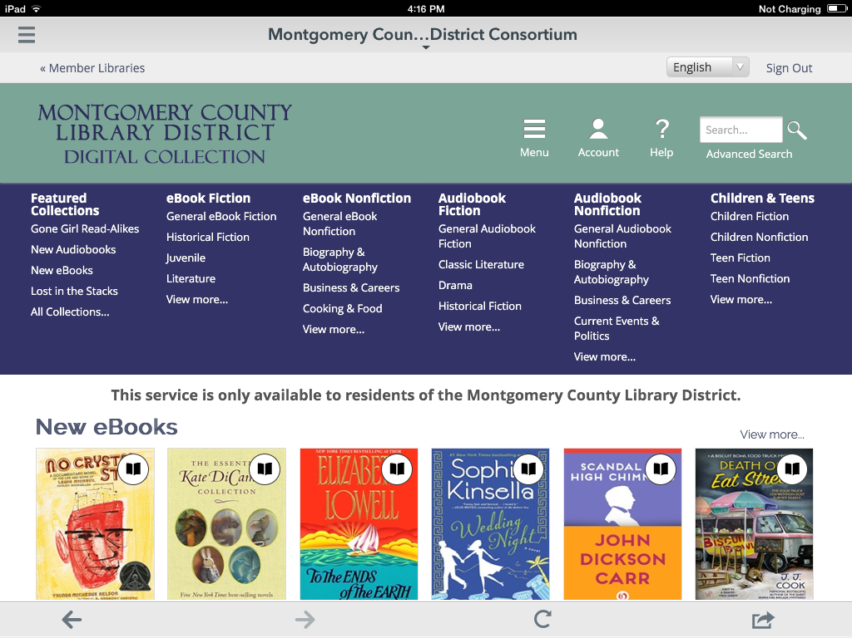
We are now signed in (as evidenced by the Sign Out link) and we are at the page where we started, the Home page.
Next, we are going to search for a book by a specific author. To do that we need to TAP on Advanced Search

Slide 34
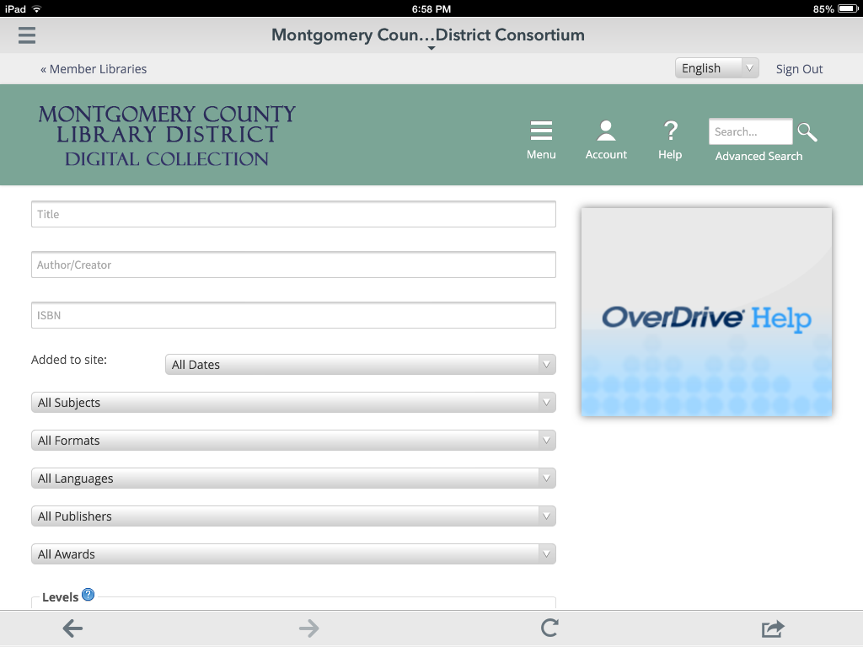
TAP in the Author/Creator field and type in Stephen King

Slide 35
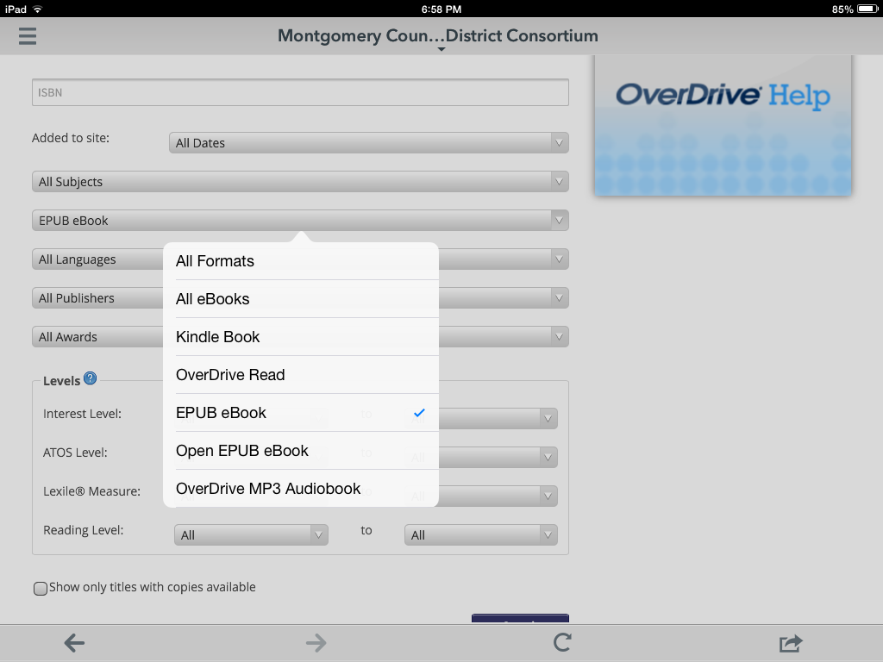
TAP on the All Formats button and then tap on EPUB eBook

Slide 36
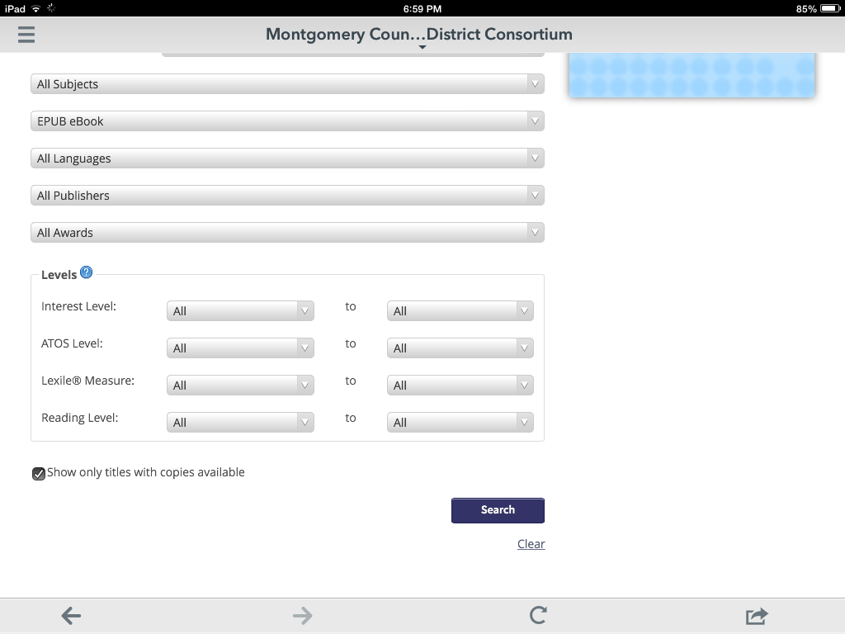
TAP in the Show only titles available box and TAP Search button

Slide 37
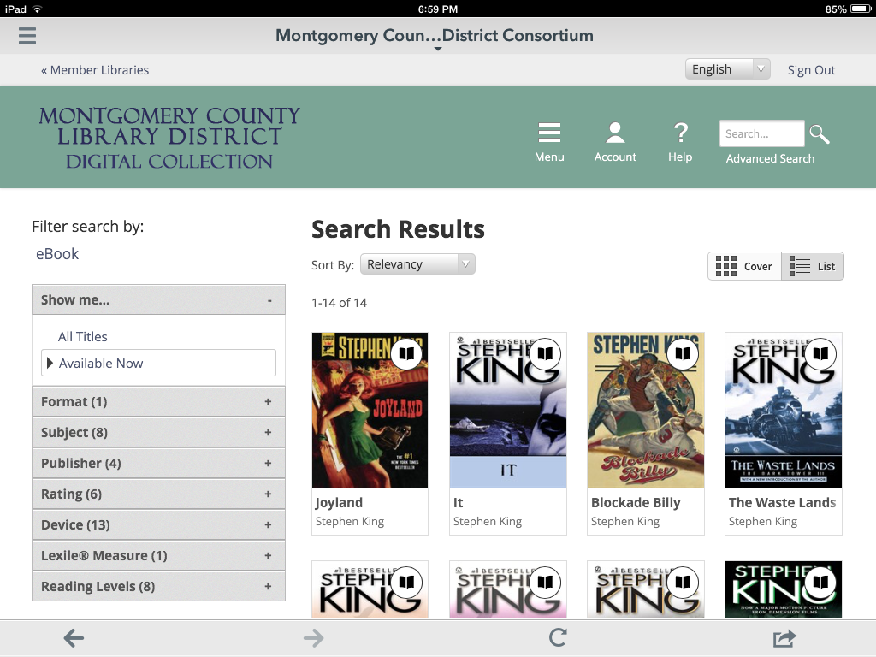
The Search results can be viewed in two different ways.
The Cover view shows only the Covers of books along with their title and author.

Slide 38
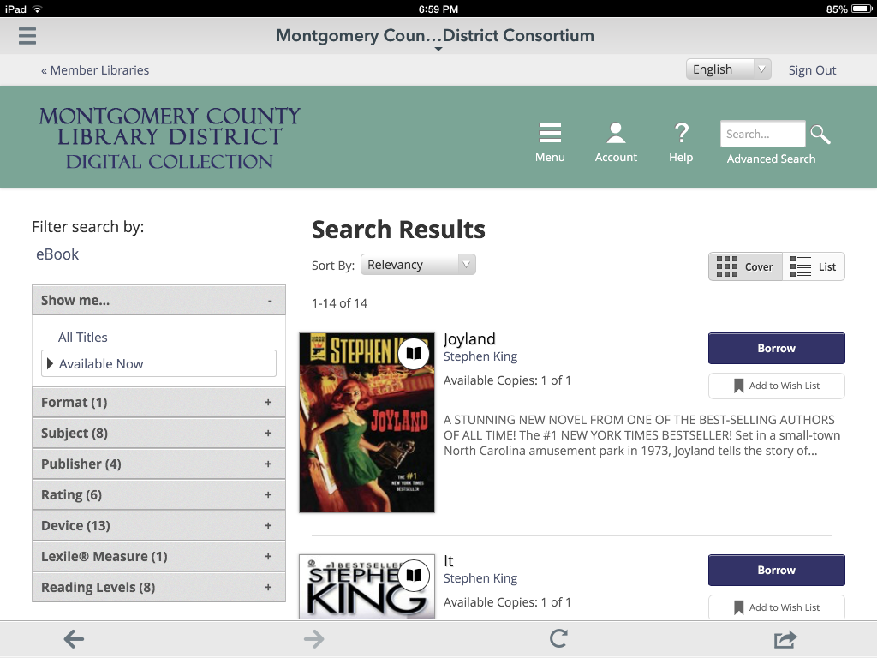
The List view gives you slightly different information and includes a Borrow button.
However, if you use the Borrow button, you won’t be able to choose a lending period.
In order to choose a lending period you need to TAP on the book cover.

Slide 39
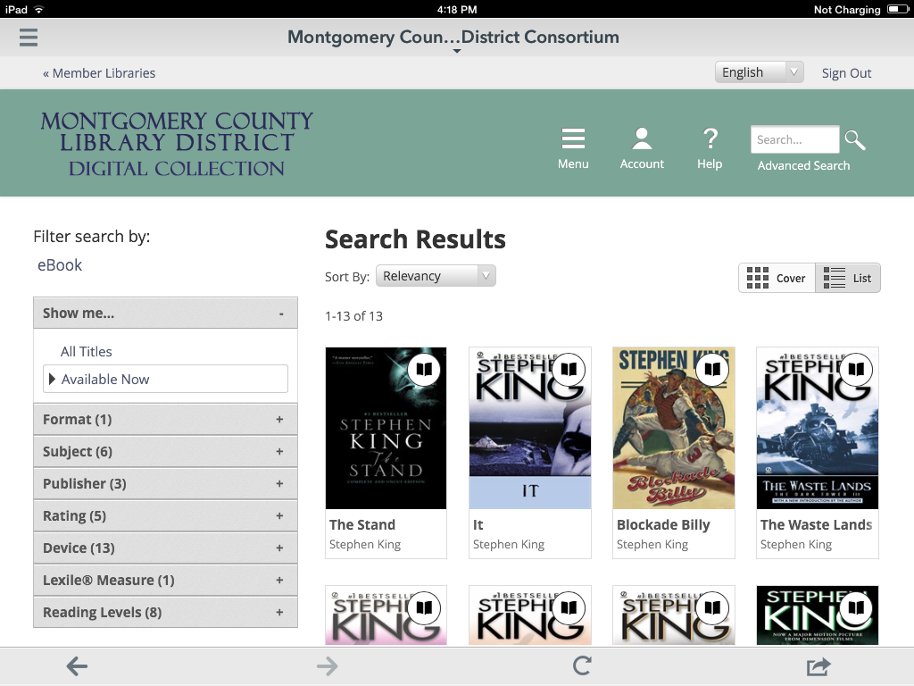
Back in the cover view, you first need to tap the picture of the book

Slide 40
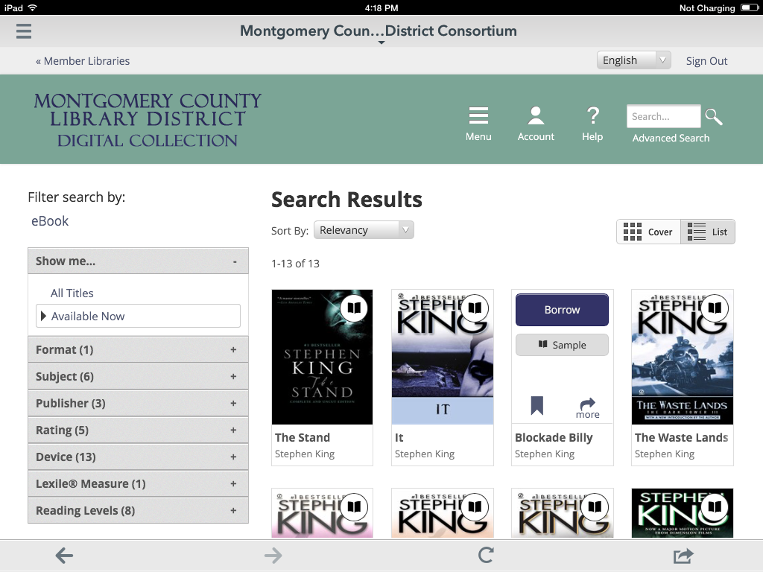
Then tap on the “more” button to get to the details page

Slide 41
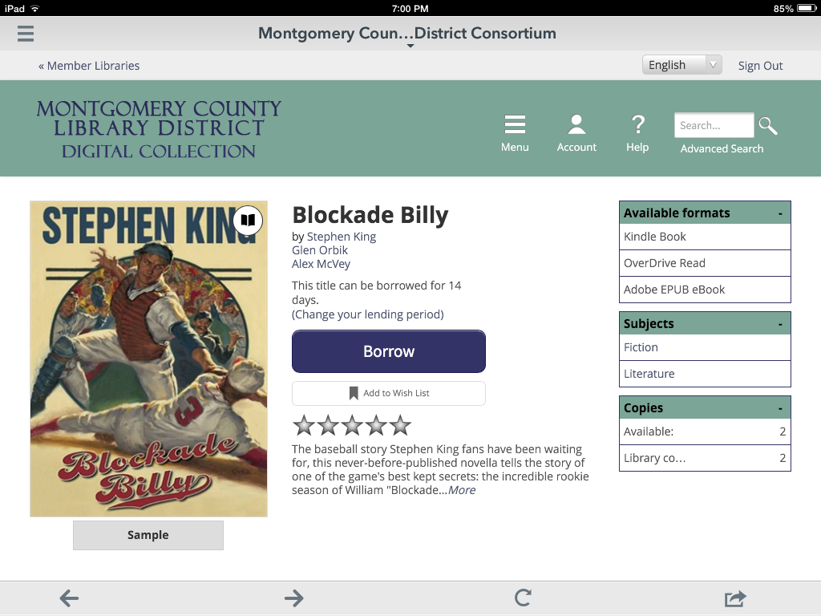
Note the Borrow button and the message underneath that says the title can be borrowed for 14 days.
This loan period draws from a setting in your account that applies to all digital loans.
The following screens show how to change this setting if you want the book for less or more time.
TAP on “Change your lending period”

Slide 42
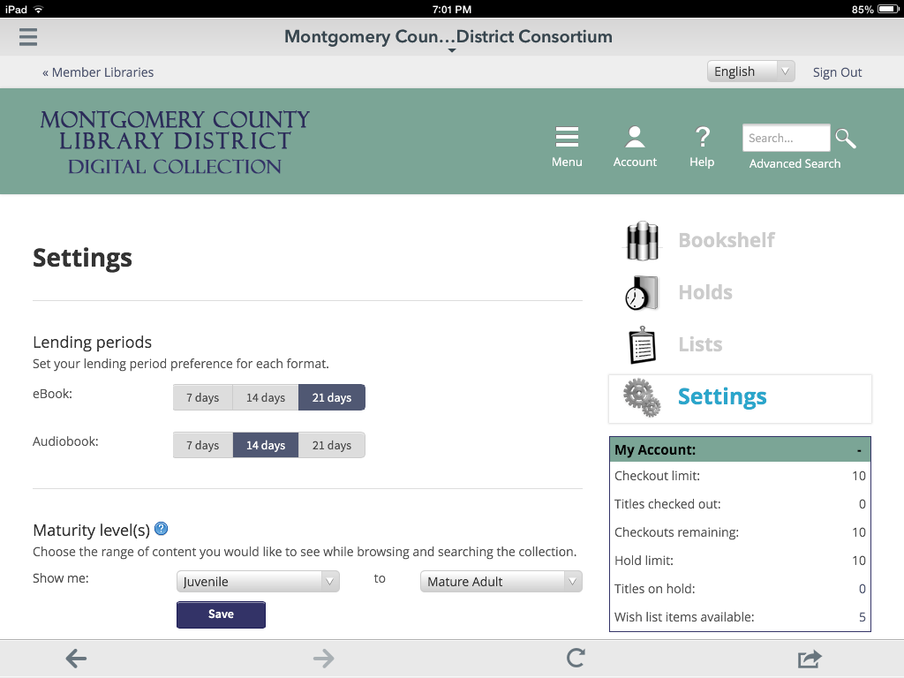
This screen is your account settings. Tap on the desired lending period for your eBooks. We going to change ours to 21 days. Then TAP the back button in the lower left.

Slide 43
Once we tap the back button, we are taken back to this screen with the Borrow button. Note that the loan period has changed.
We are ready to TAP Borrow.

Slide 44
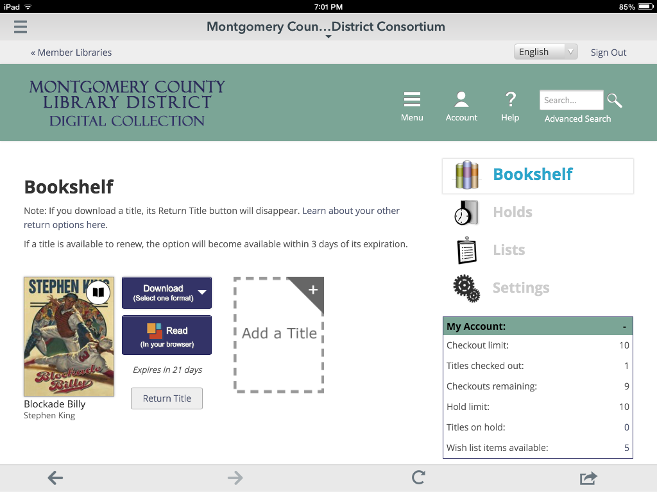
Once the Borrow button is tapped you are taken to your OverDrive online Bookshelf where you will see the Download button.
If you have made a mistake or change your mind, you can return the item before you download it. Once you download an item, it can only be returned using the controls in the OverDrive app.

Slide 45
Now we are going to download Blockade Billy. Even though we searched for EPUB eBooks, the download button will show all available formats. TAP on the Download button.

Slide 46
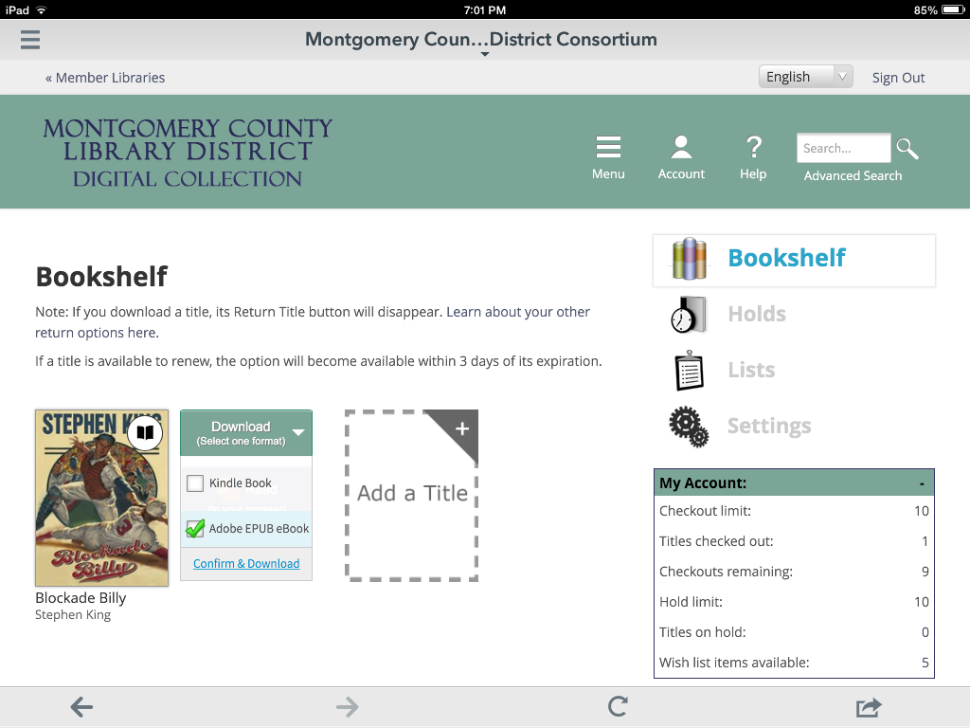
The available formats list drops down and, in this case, we will TAP on EPUB eBook and a checkmark appears.
BE SURE TO SELECT THE CORRECT FORMAT. The process is irreversible.
Then TAP on Confirm & Download

Slide 47
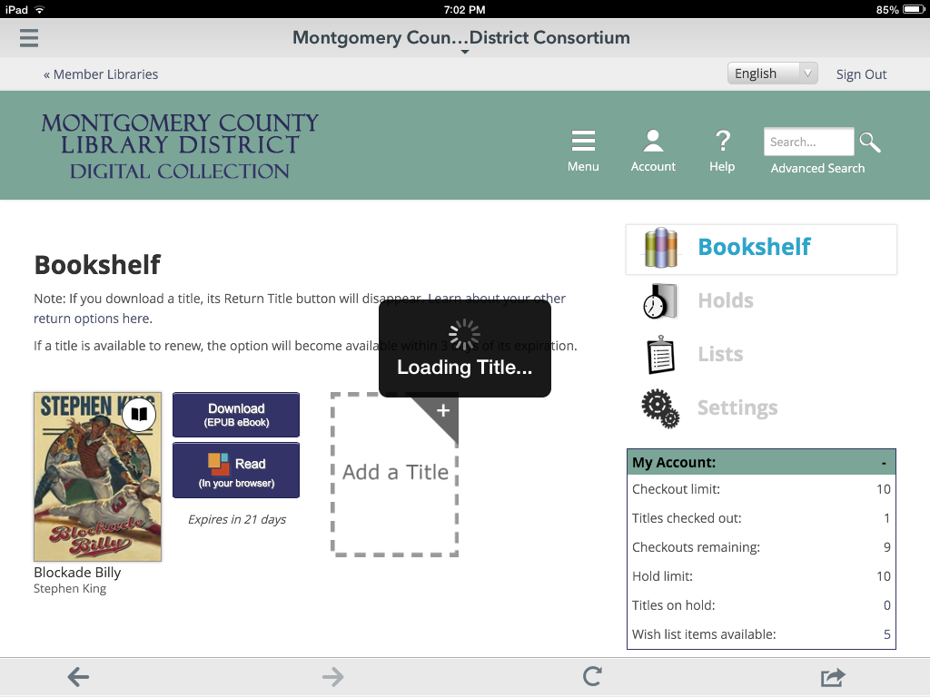
Our eBook begins to download automatically

Slide 48
You will notice that the download button no longer has the “Select one format” button. Once you select the format, you will be unable to change it back until you return the book from the app and borrow it again.

Slide 49
To read your book you need to get to the Bookshelf that comes with the OverDrive app. TAP the Menu button (upper left).

Slide 50
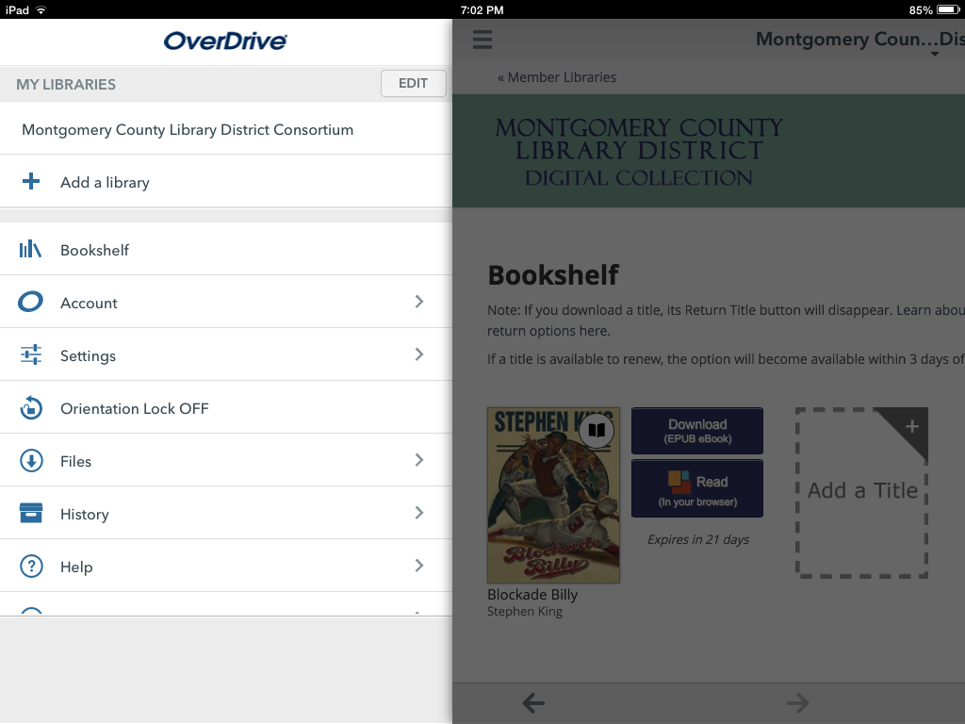
Tap on Bookshelf

Slide 51
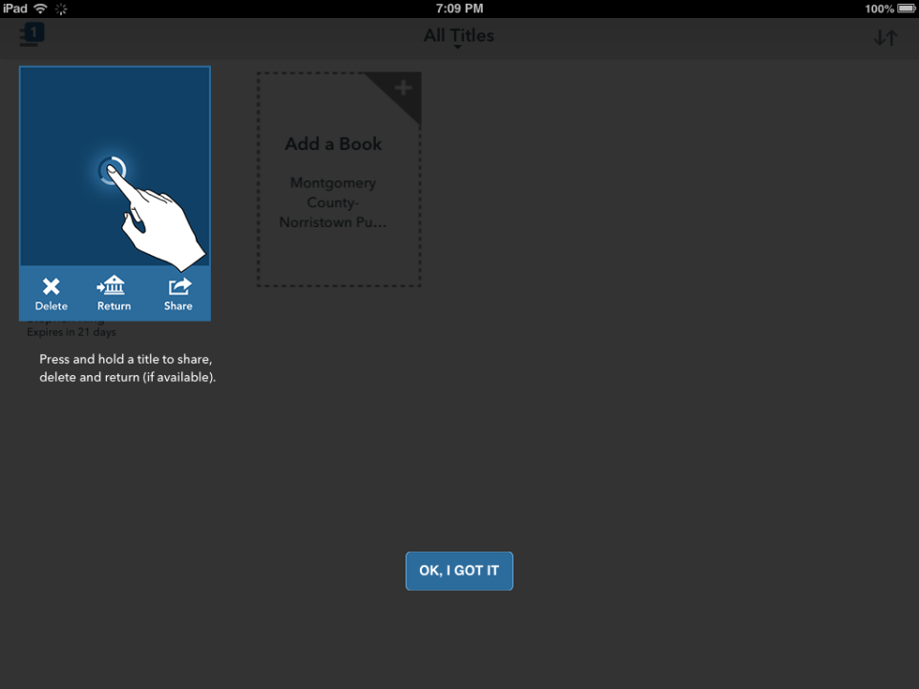
The first time you go to your bookshelf, you will get an information prompt. Just tap OK to close

Slide 52
This is the Bookshelf for the OverDrive app. To open the book, TAP on the cover.

Slide 53
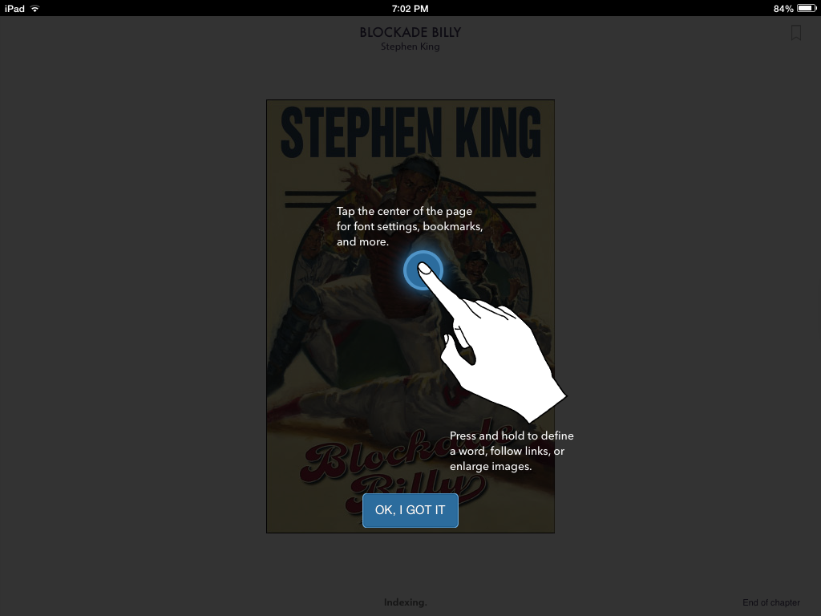
The first time you open a book on OverDrive, you will get an instructional prompt on how to navigate through books. Tap OK to continue

Slide 54
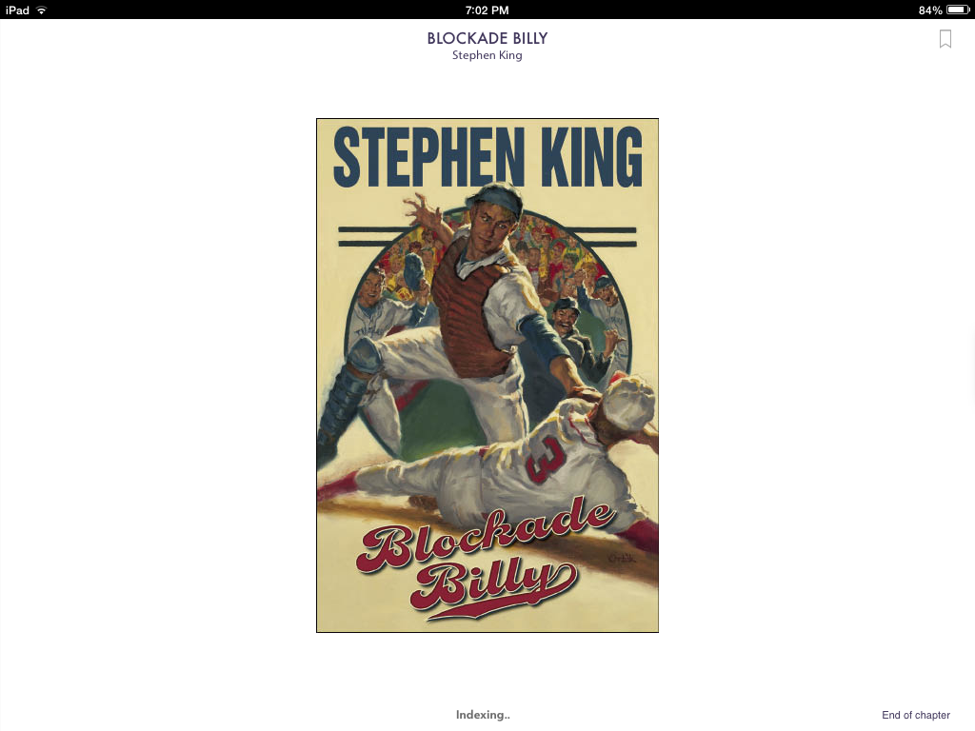
The book is open. You swipe to navigate between pages

Slide 55
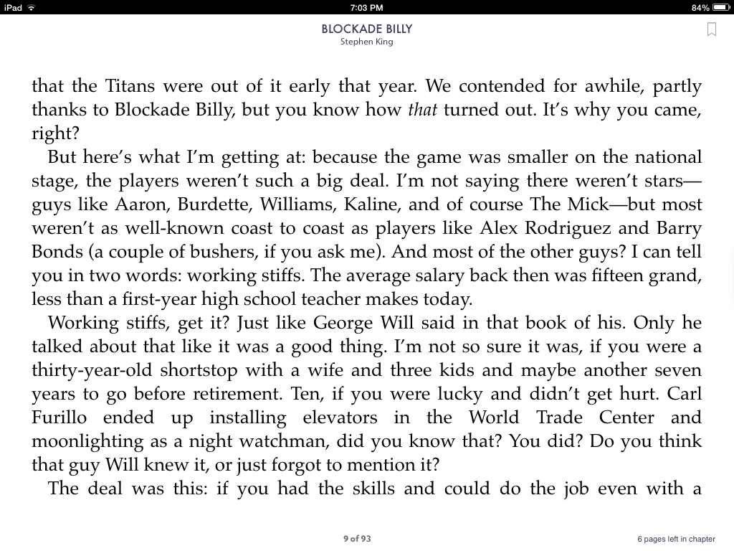
Your place in the book will automatically be saved, but if you think you would like to re-read this page in the future, you would use the bookmark. TAP the bookmark button.

Slide 56
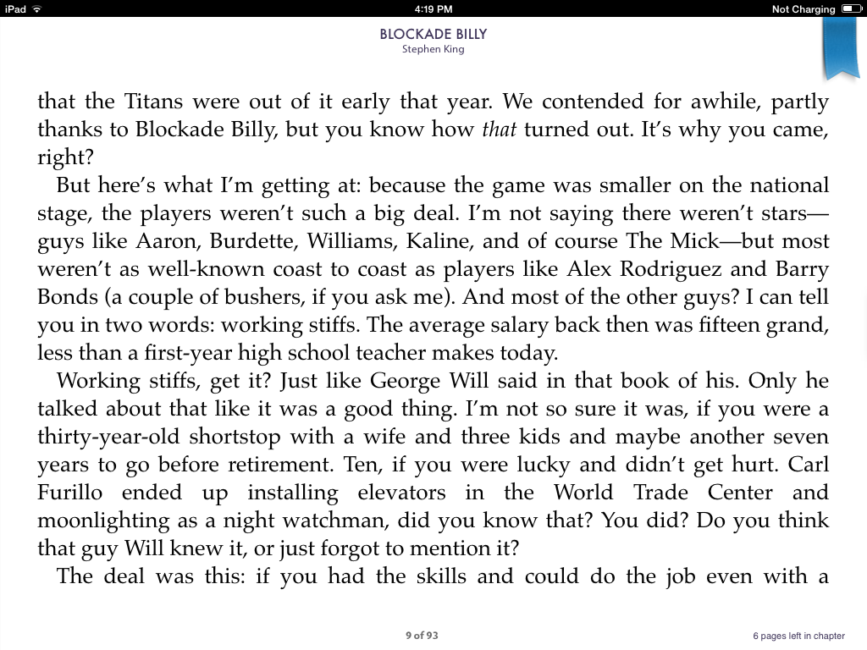
The bookmark is highlighted.
To see more controls TAP the middle of the page.

Slide 57
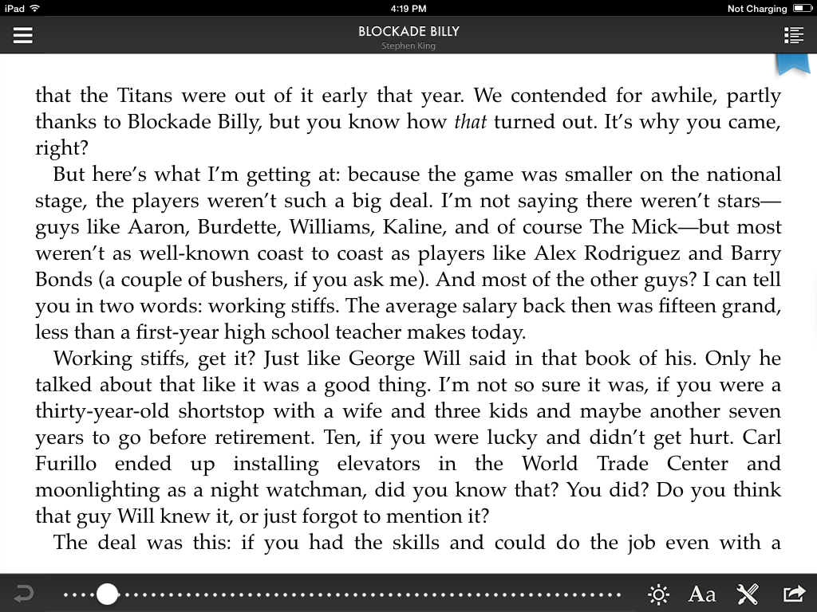
A navigation bar at bottom shows where you currently are in book. You can drag this slider back and forth to quickly move throughout the book.

Slide 58
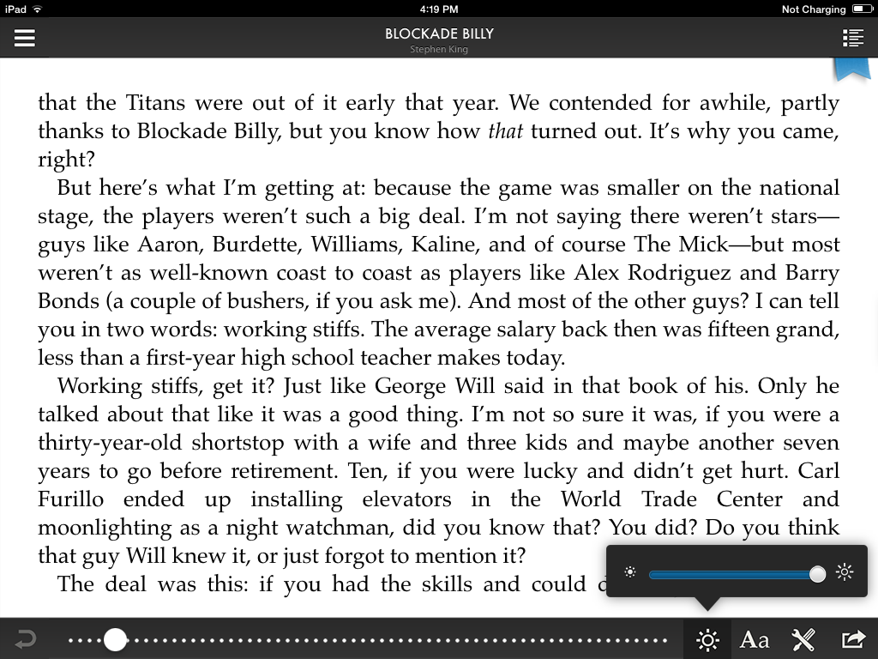
Tap brightness button to make adjustments on a slider.

Slide 59
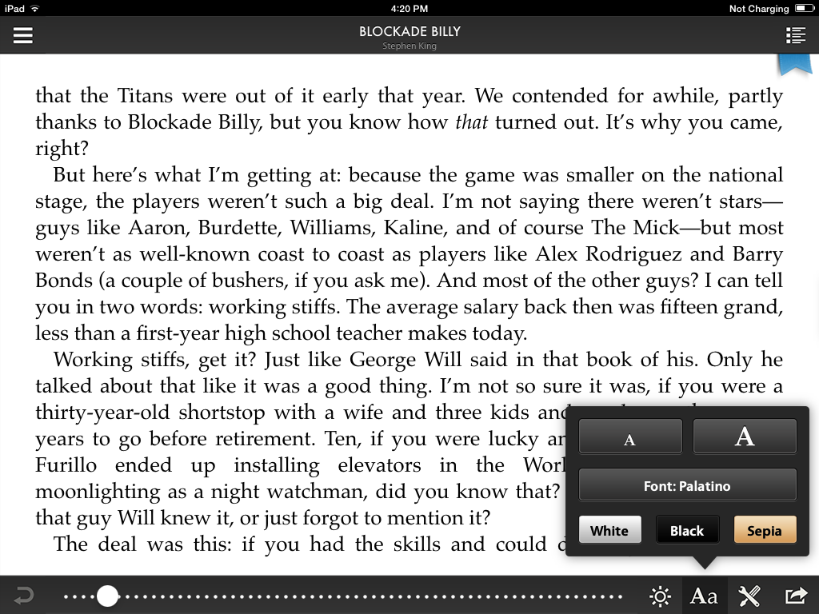
Tapping the font options allows you to change different styles

Slide 60
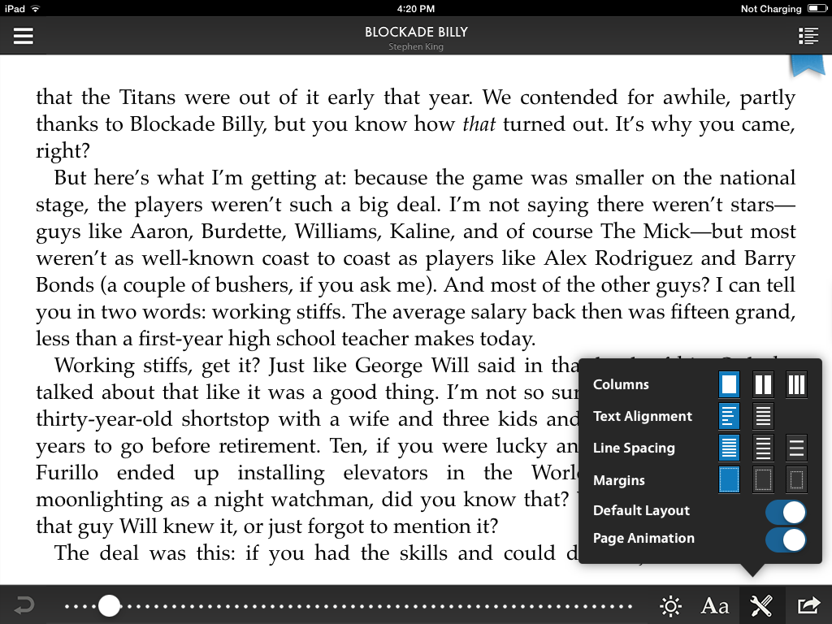
You can change the text layout of the book through the Settings button.

Slide 61
To navigate better through the book, tap the Navigation menu button

Slide 62
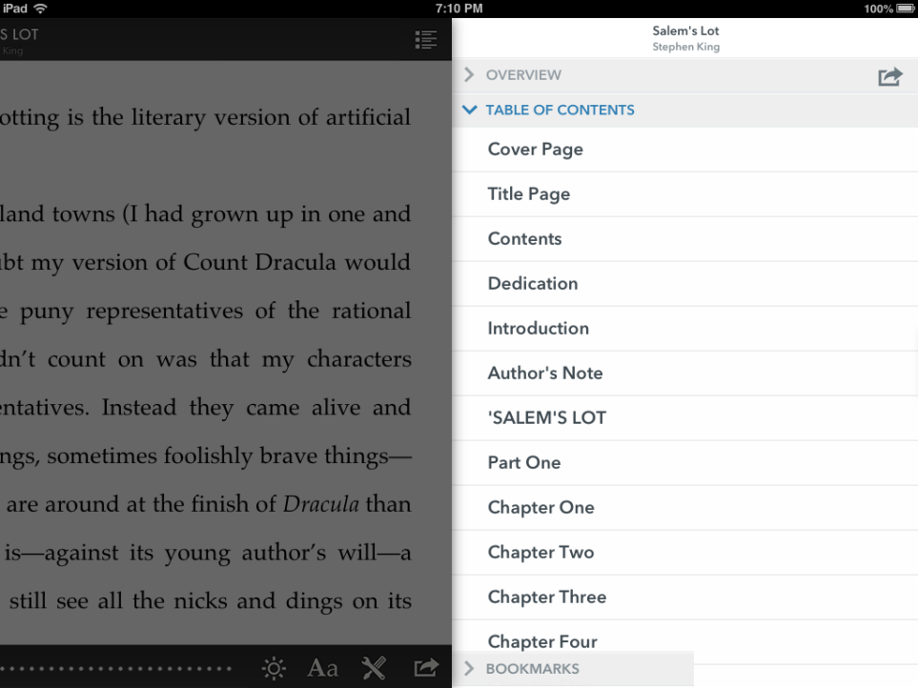
With the navigation menu, you can simply tap on a chapter and go directly to that page. Keep in mind that not all books you download will be encoded with a table to contents, so you will have to navigate by swiping only.
Now tap on the Bookmarks submenu

Slide 63
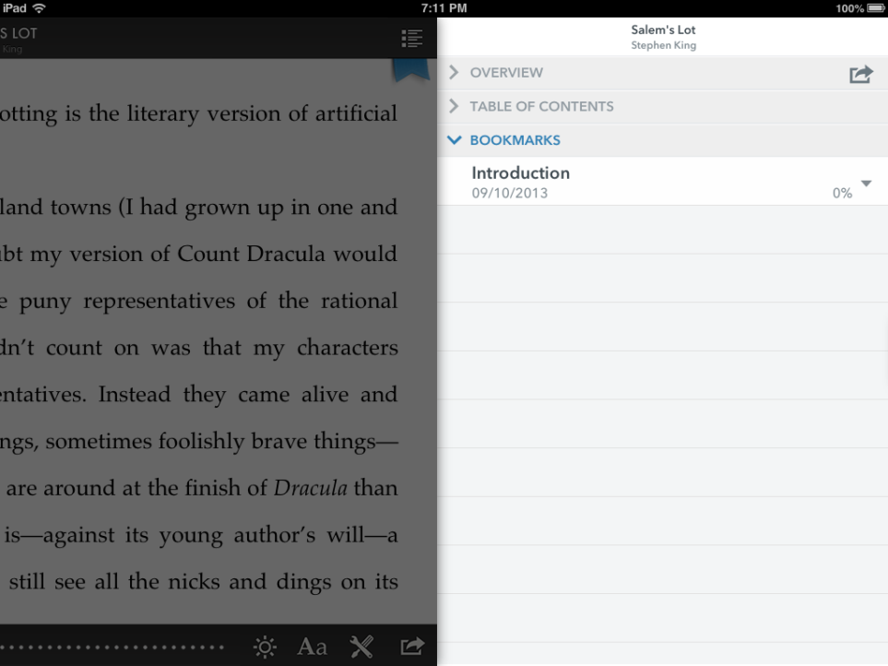
The bookmark that we created earlier is shown.
Tap anywhere in the left half of the screen to return to the book.

Slide 64
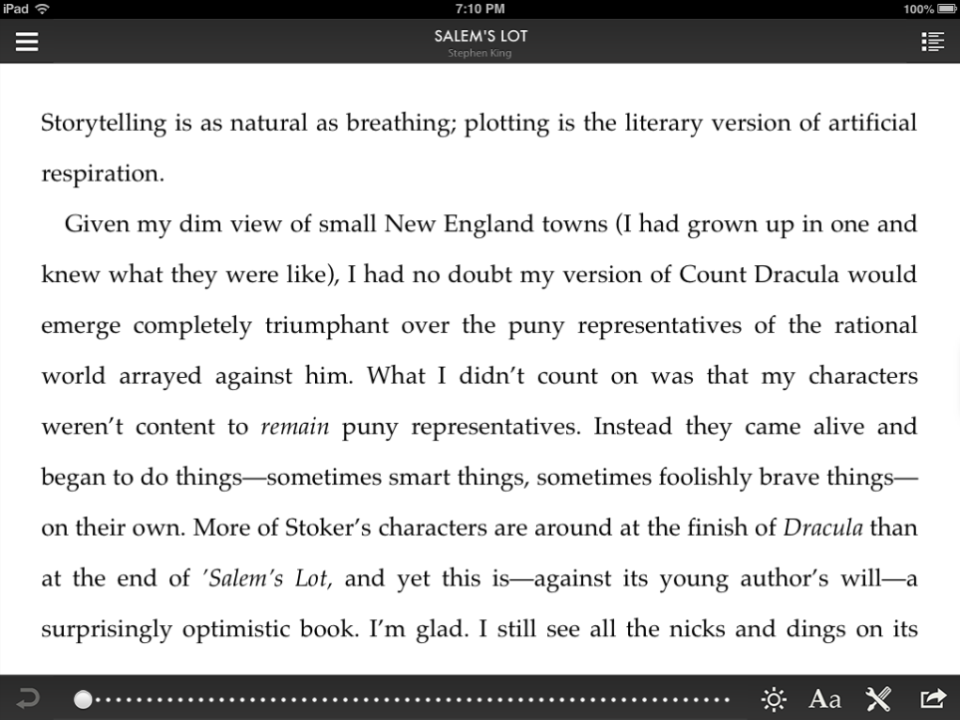
Tap the Main Menu button.
Remember, if you don’t see the menu button, you can tap the middle of the screen to bring up all of the controls.

Slide 65
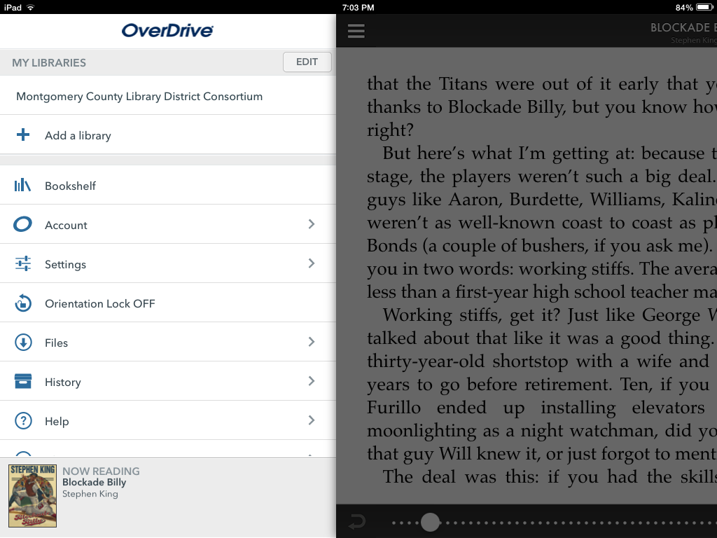
Tap Bookshelf to bring you back to the app’s bookshelf where we will return the book.

Slide 66
To return a book, TAP and HOLD on the cover of the book you want to return

Slide 67
TAP on Return

Slide 68
TAP on Return again to confirm

Slide 69
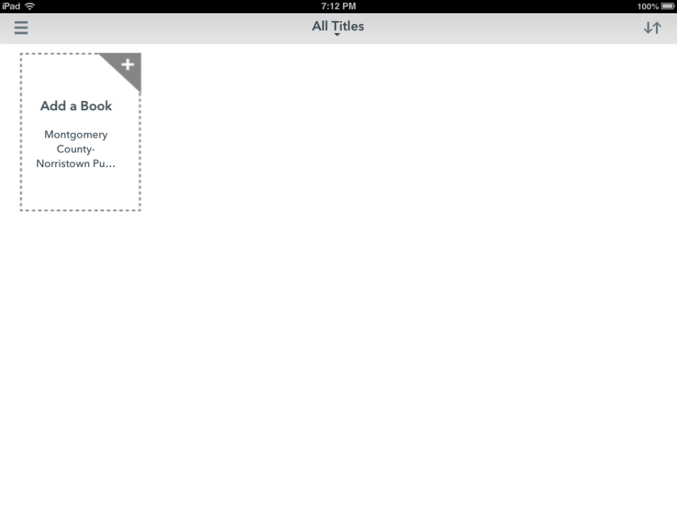
The book has been returned and also deleted from your device. To download another book, tap on the “Add a Book” button to begin your search again.
HAPPY eREADING on your IPAD!

